Slide 1

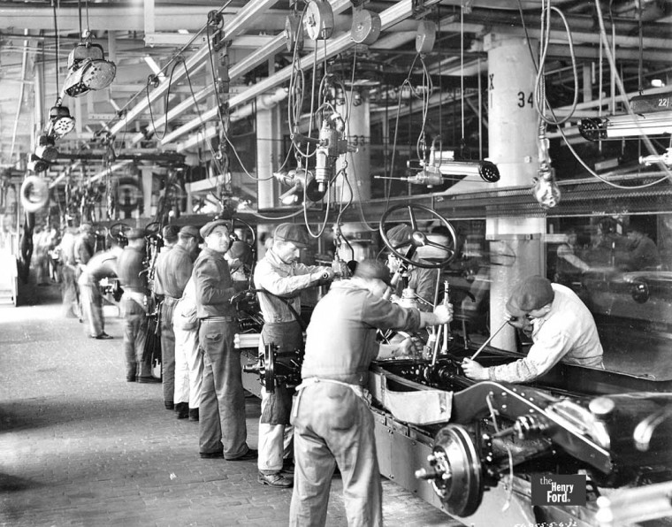
Introduction to Processes
Data Decomposition
Task Decomposition

Slide 2
Processes memory architecture
Stack
Declared inside functions/params
Created with new or malloc
Free Memory
Heap
Globals and static members
Static

Slide 3
Every process has its own “memory space”
Stack
Stack
Stack
Address 0xDEADBEEF in process 1 is *not* the same location as 0xDEADBEEF in process 2
The OS/MM translates virtual addresses to a physical location
What happens when a process tries to access an address with no physical association?
Free Memory
Free Memory
Free Memory
Heap
Heap
Heap
Static
Static
Static

Slide 4
Every process has its own “memory space”
Stack
Stack
Stack
Address 0xDEADBEEF in process 1 is *not* the same location as 0xDEADBEEF in process 2
The OS/MM translates virtual addresses to a physical location
What happens when a process tries to access an address with no physical association?
SEGFAULT
Free Memory
Free Memory
Free Memory
Heap
Heap
Heap
Static
Static
Static

Slide 5
A fork/clone call creates a new process
Both run the exact same program at exact same PC, but each has its own memory. Share/inherit files and sig handlers.
Stack
Stack
Stack
Signal Handers
Fork()
Free Memory
Free Memory
Free Memory
Heap
Heap
Open Files
Heap
Static
Static
Static

Slide 6
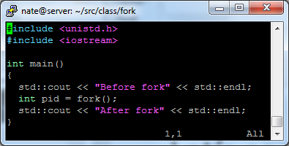
Let’s code
Start small
What is this going to do? Any guesses?

Slide 7
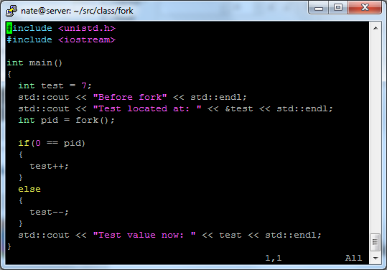
Differentiate parent and child
Fork() return value
What is this going to do?

Slide 8
How do we move data between processes (i.e. Inter Process Communication – IPC)
Sockets (We’ll save this one for the networking class)
Message queue
Shared memory
FIFO / pipe

Slide 9

Message Queues
Graceful handling of race
Blocking reads and writes
Requires data copy
Message Queues
Producer Process
Provided by Linux (OS)
Consumer Process
Producer Process
Consumer Process
MSG FIFO
First in first out
Sorted by priority
Variable length
Treated as atomic unit

Slide 10
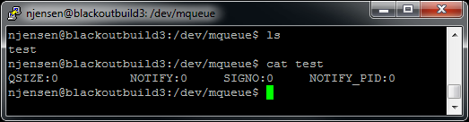
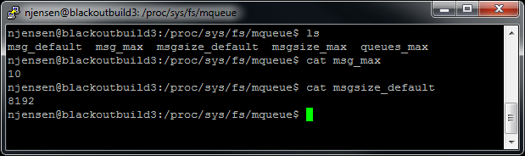
Message Queues
Like everything in Linux, it looks like a file
mkdir /dev/mqueue
mount –t mqueue none /dev/mqueue
Now you can see all the messages queues provided by the OS
Exists until unlink or reboot
Can see/change limits/sizes

Slide 11
Shared Memory
Race conditions abound
Looks like normal memory
Doesn’t require memcpy
May be executable
Shared Memory
Provided by Linux (OS)
Shared Buffer
Process
Process
Process
Process

Slide 12
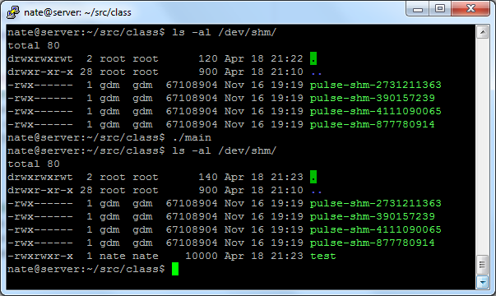
Shared Memory
Like everything in Linux, it looks like a file
Exists until unlink or reboot
Can see/change limits/sizes

Slide 13
Pipes and FIFOs
Minimal race guarantees
Blocking reads and writes
Requires data copy
Stream of bytes
Order preserved WRT producing process
Named FIFO or Pipe
Producer Process
Provided by Linux (OS)
Consumer Process
Producer Process
Consumer Process
BYTE FIFO
First in first out
No priority

Slide 14
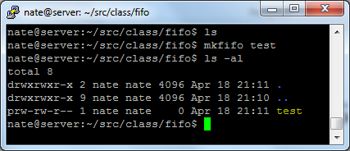
Pipes and FIFOs
Can look like a file if named
May be pipe only and inherited accross fork
Exists until unlinked
Must be open on both ends before use

Slide 15
Documentation You Need/Want
Linux comes with documentation/manual pages built in
They are called ‘man’ pages for short
There is even a man page for the man command
Here is some reading needed for programming exercise
man mq_overview
man shm_overview
man pipe
man mkfifo

